Slide 1
IPL Match Analysis Report
By- Raiyana Reyaz

Slide 2
INTRODUCTION
Analyzed IPL data using Power BI.
Aim: find insights on teams, players, and match outcomes.
Built an interactive dashboard with filters, KPIs, and charts.
Helps in understanding trends and improving strategies.

Slide 3
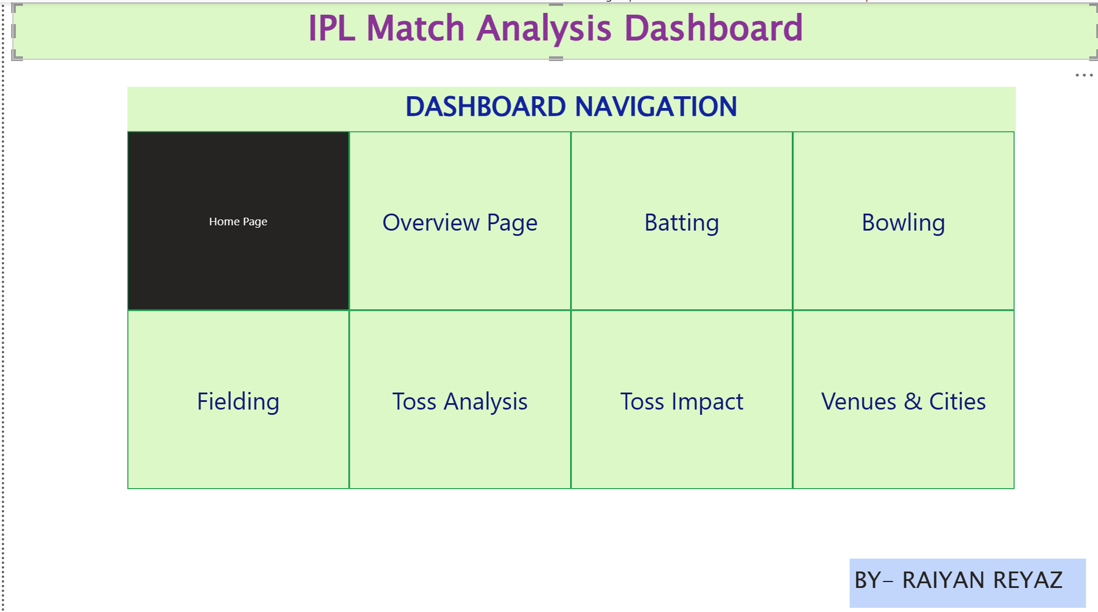
Dashboard Navigation
THE DASHBOARD IS DIVIDED INTO MULTIPLE PAGES FOR EASY NAVIGATION AND ANALYSIS, COVERING : BATTING,BOWLING,TOSS IMPACT,VENUES AND MORE.

Slide 4
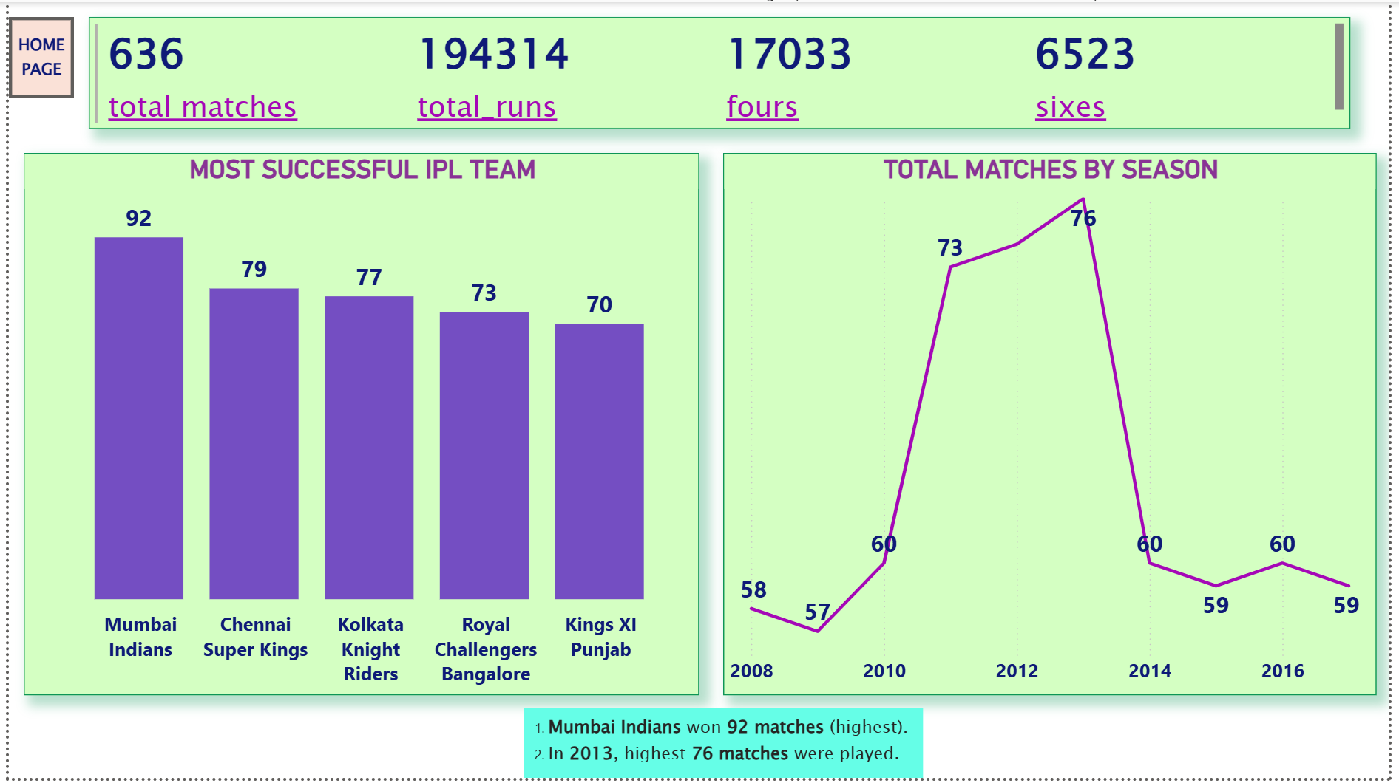
OVERVIEW PAGE
KEY INSIGHTS:
1. KPIs on top- provide a quick snapshot of the dataset.
2. Most Successful IPL Teams (Bar Chart)
Mumbai Indians lead with 92 wins
3. Matches by Season (Line Chart)
Lowest matches in 2009 (57)
Matches peaked in 2013 (76 matches), the highest season.

Slide 5
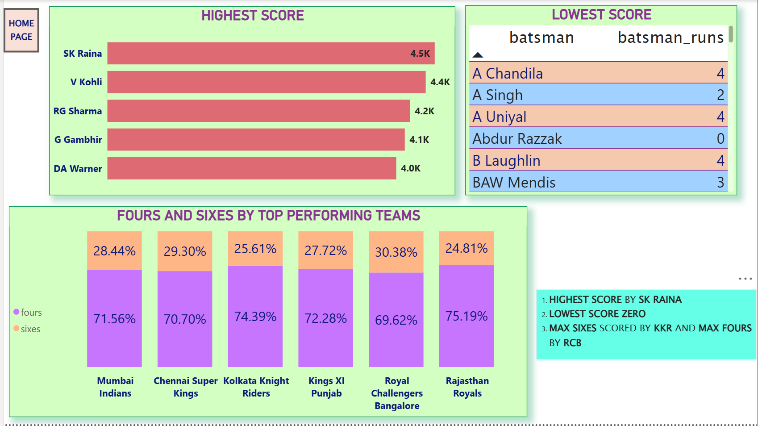
BATTING INSIGHTS
KEY INSIGHTS:
1. Highest scorer: Suresh Raina (4.5K runs) followed by Virat Kohli and Rohit Sharma.
2. Multiple players registered zero runs, indicating no batting impact in their IPL stint.
3. Boundary pattern:
RCB hit the highest % of sixes (30.38%).
Rajasthan Royals also leaned heavily on fours (75.19%).

Slide 6
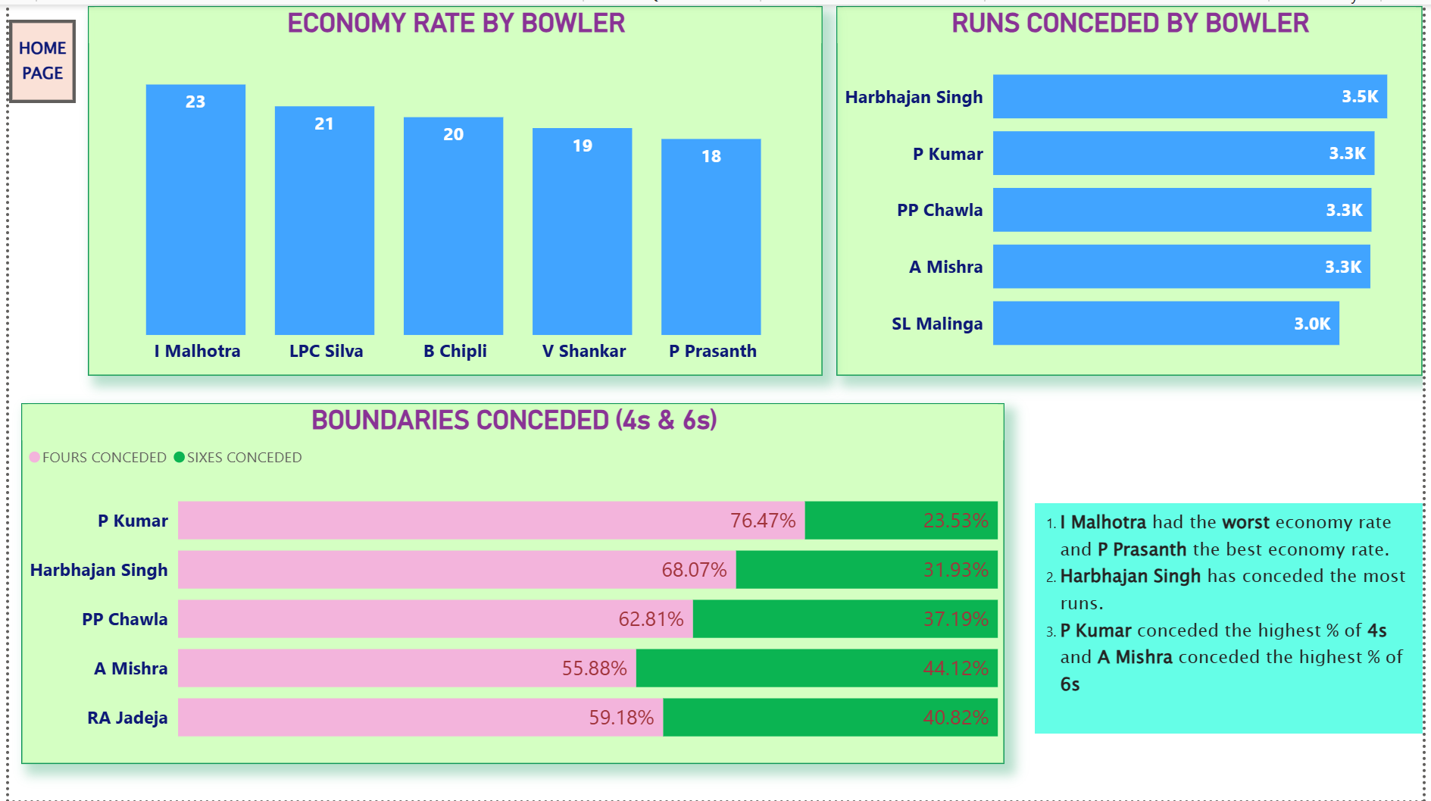
BOWLING INSIGHTS
KEY INSIGHTS:
1. Economy Rate:
I Malhotra recorded the worst economy rate.
P Prasanth had the best economy rate among the shown bowlers.
2. Runs Conceded: Harbhajan Singh conceded the highest runs (3.5K).
3. Boundaries Conceded:
P Kumar gave away the highest share of fours (76%).
A Mishra conceded the highest share of sixes (44%).

Slide 7
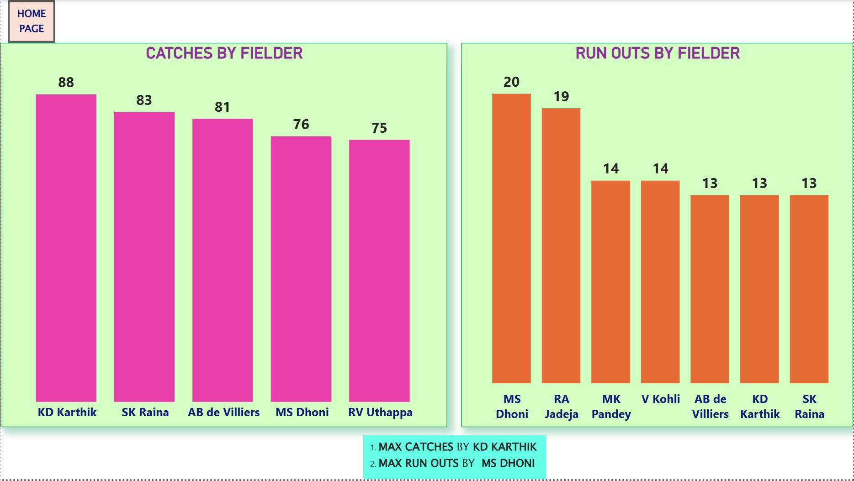
Fielding Insights
KEY INSIGHTS:
1. Catches: KD Karthik leads with 88 catches, followed by Suresh Raina (83) and AB de Villiers (81).
2. Run Outs: MS Dhoni tops with 20 run outs, closely followed by Ravindra Jadeja (19).

Slide 8
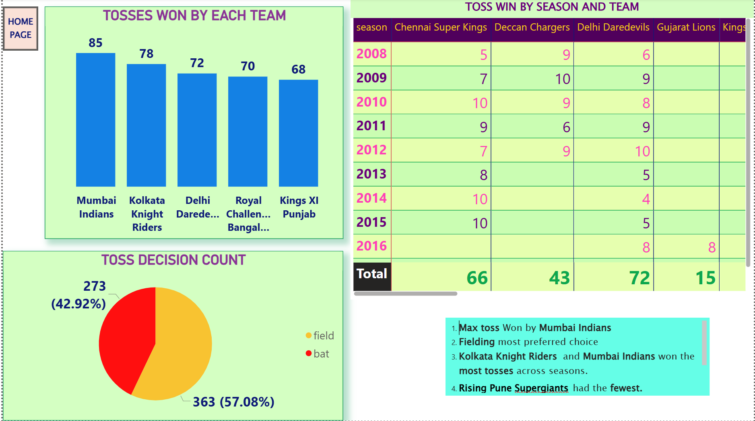
TOSS ANALYSIS
KEY INSIGHTS:
1. Most Toss Wins: Mumbai Indians (85), followed by Kolkata Knight Riders (78).
2. Fewest Toss Wins: Rising Pune Supergiants (6)
3. Toss decisions leaned towards fielding (57%), showing teams preferred chasing targets rather than setting them.

Slide 9
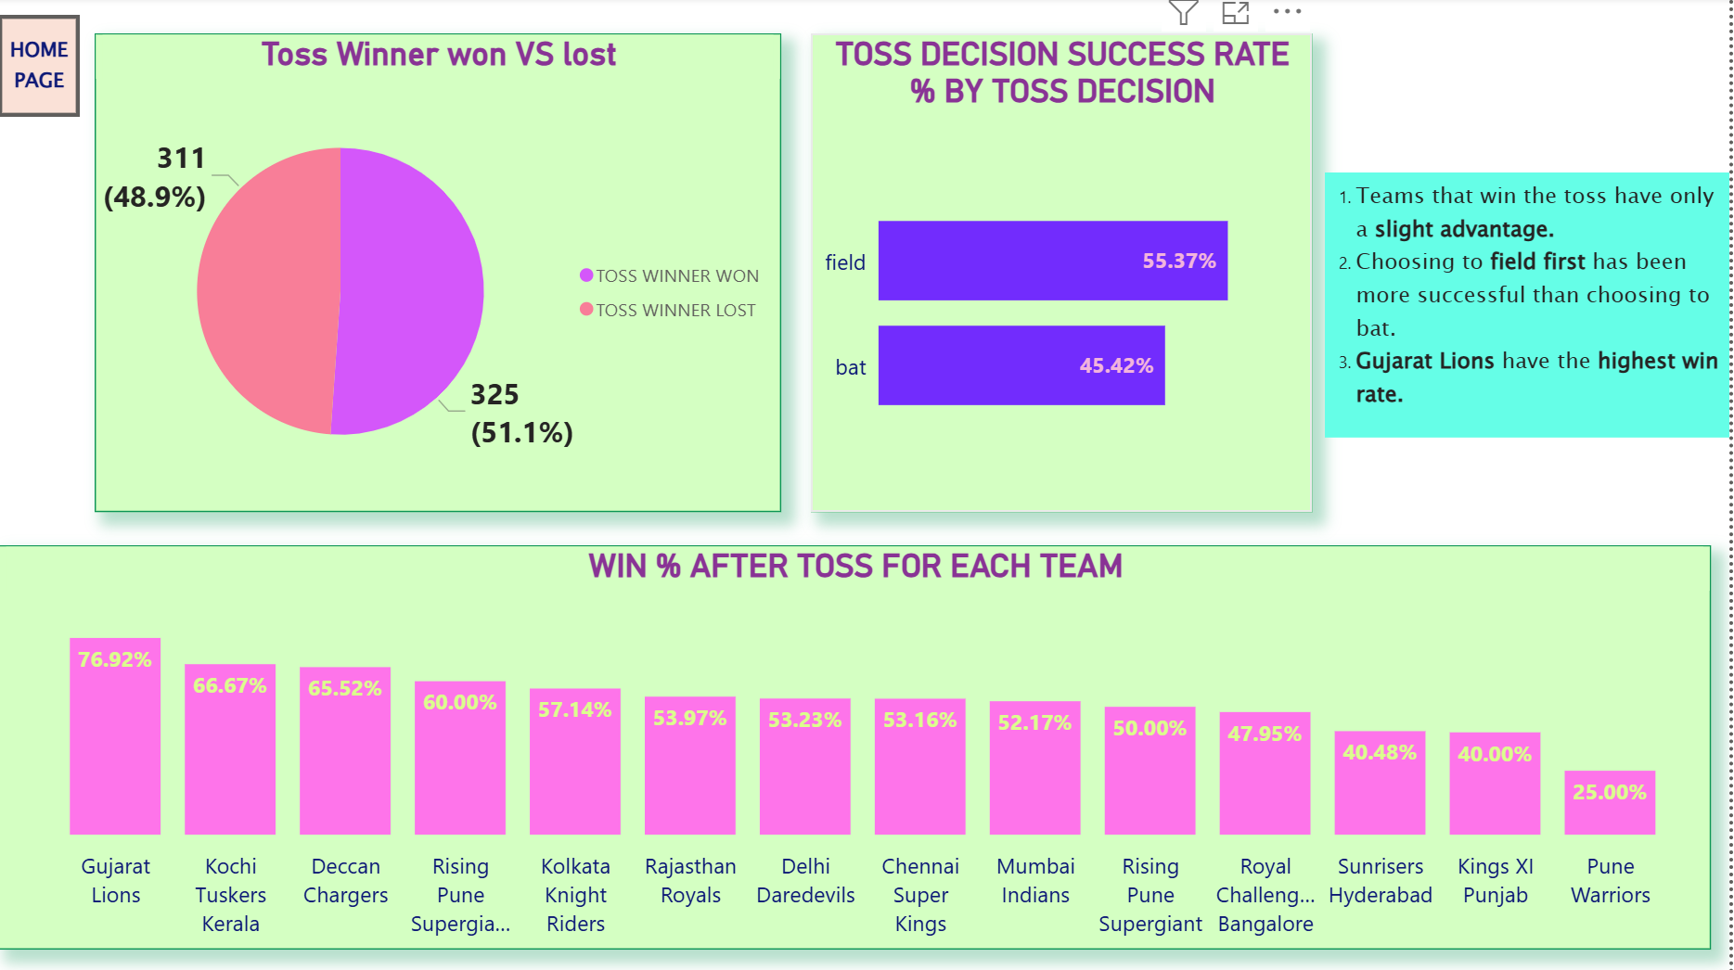
TOSS IMPACT
KEY INSIGHTS:
Toss win gives only a small advantage (51% vs 49%).
2. Field first decisions lead to better results than batting first.
3. Gujarat Lions have the best win rate after toss wins.

Slide 10
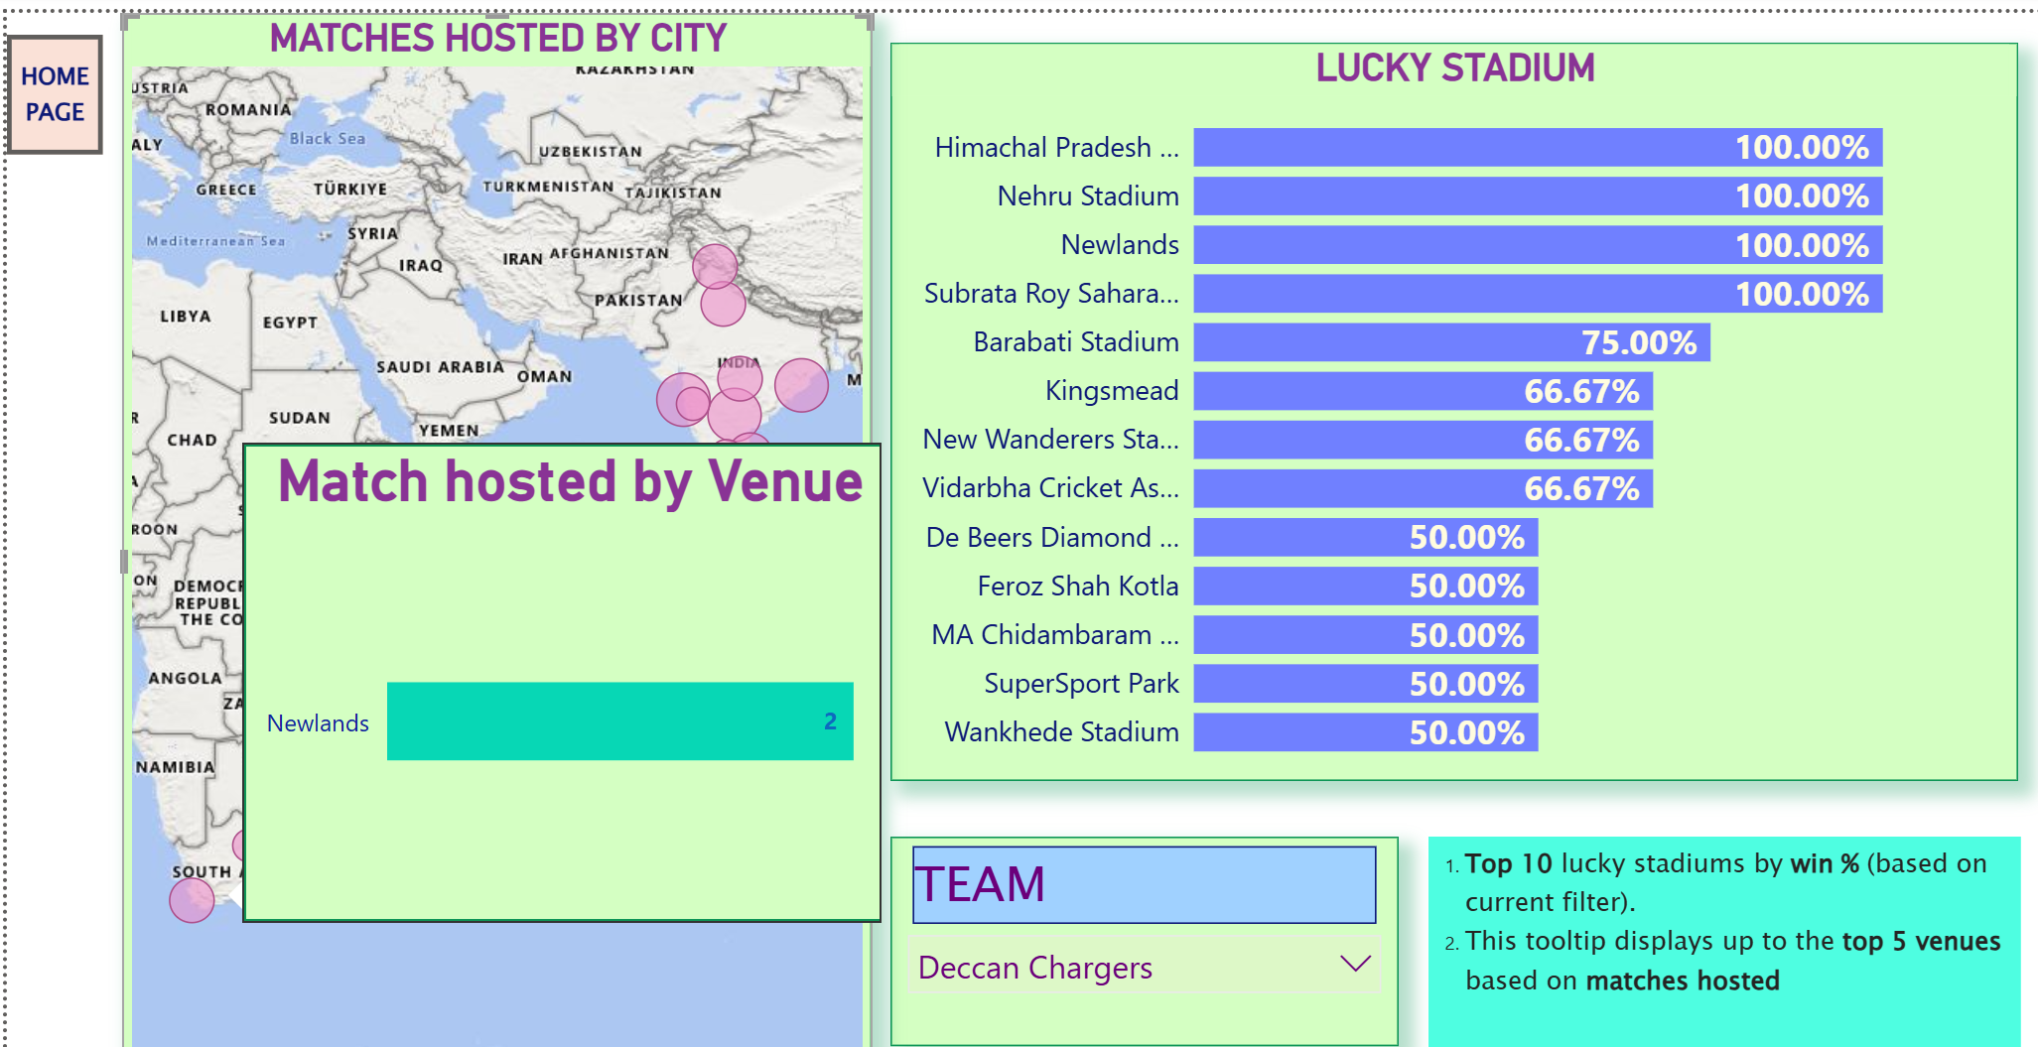
VENUES AND CITIES INSIGHTS
KEY INSIGHTS:
Newlands stadium hosted 2 matches for Deccan Chargers.
Newlands is also among the top lucky stadiums with a 100% win record for the team.

Slide 11
INSIGHTS AND RECOMMENDATIONS
Insights from Analysis:
Certain venues act as “lucky stadiums” for some teams, while others consistently struggle there.
Toss decisions (bat/field) strongly influence outcomes, but their success varies across venues.
Top performers (both batsmen and bowlers) have a clear impact on match results, with some teams over-relying on star players.
Seasonal trends show some teams improving in specific phases, while others decline after early success.
Key Recommendations for Teams:
Develop venue-specific strategies instead of following a uniform approach.
Optimize toss decisions by analyzing historical outcomes at each ground.
Reduce dependence on top-order batsmen; strengthen middle-order to handle collapses.
Utilize powerplay bowlers with better economy in batting-friendly venues.
Conduct match simulations for venues where win % is historically low to rework strategies.

Slide 12
THANK YOU

